Slide 1
PerfTest: Profiling Applications via ARM and TPTP
Yoonki Song
Last Updated: Sep. 16, 2009

Slide 2
Profiling
Prerequisites

Slide 3
Instrumentation
# /root/perftest/gotoARM.sh
Start WebSphere Application Server (WSAS)
Note: WSAS should be running before applications are instrumented.
Start Instrumentation
Restart the server
Note: This task should be done only once.

Slide 4

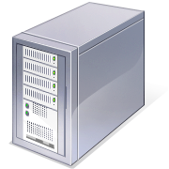

Environment for ARM Instrumentation
Client:
My desktop (Dynamic IP)
Rational Performance Tester v8.0
with Agent (Data Collection Inftrastructure v7.0)
Server:
eb2-2241-grd03.csc.ncsu.edu (152.14.90.72)
WebSphere Application Server v6.1
Rational Performance Tester Agent
(Data Collection Inftrastructure v7.0)

Slide 5

Sequence for Collecting Trace data with Instrumentation (RPT-ARM)
Client
Server
#/root/perftest/startARM.sh
Start Rational Agent Controller (RAC)
Note: RAC should be running prior to DCI
Start Data Collection Infrastructure (DCI)
Note: DCI should be running prior to WSAS
Start WebSphere Application Server (WSAS)
4. Start DCI
5. Start RPTv8.0
6. Start Recording and Launching Test/Schedule via RPT
Trace data (A)
Note: This task should be always done whenever the server/client reboots.
Notes:
3451 <- x
4513 <-

Slide 6
Converting ARM-instrumented to TPTP Environment
Client
Server
Check if WSAS is running
If not, start WSAS
Un-instrumentation
Reboot the server

Slide 7
Environment for non-ARM Instrumentation
Client:
My laptop (Dynamic IP)
TPTP all-in-one v4.5.1
with Agent (Data Collection Inftrastructure v7.0)
Server:
eb2-2241-grd02.csc.ncsu.edu (152.14.90.8)
WebSphere Application Server v6.1
Standalone Agent Controller
(Data Collection Inftrastructure v7.0)

Slide 8

Sequence for Collecting Trace data with non-ARM Instrumentation(TPTP)
Client
Server
/root/perftest/*.sh
Start TPTP Agent Controller (TPTP-AC)
Start Data Collection Infrastructure (DCI)
Start WebSphere Application Server (WSAS)
4. Use TPTP to collect trace data
5. Our plug-in analyzes trace data (B)
Trace data (B)

Slide 9
Environment Variables on Windows
JAVA_PROFILER_HOME=%TPTP_AC_HOME%\plugins\org.eclipse.tptp.javaprofiler
TPTP_AC_HOME=C:\DevTools\eclipse\tptp.runtime.allInOne.win32.win32.x86-TPTP-4.5.1
PATH=%PATH%;%JAVA_PROFILER_HOME%;%TPTP_AC_HOME%\bin

Slide 10
.bashrc on Linux
# “PerftTest(ARM)” project
# “PerftTest(TPTP)” project
export TPTP_AC_HOME=/opt/TPTP
export JAVA_PROFILER_HOME=$TPTP_AC_HOME/plugins/org.eclipse.tptp.javaprofiler
export PATH=$TPTP_AC_HOME/bin:$JAVA_PROFILER_HOME
export LD_LIBRARY_HOME=$LD_LIBRARY_HOME:

Slide 11
File extensions
Extension | Description
executiondlr
Trcadlr
Trcaxmi | Trace Agent
Trciovxmi
Trcmxmi | Trace Monitor
Trcnxmi | Trace Node
Trcpxmi | Trace Process
trcxml

Slide 12
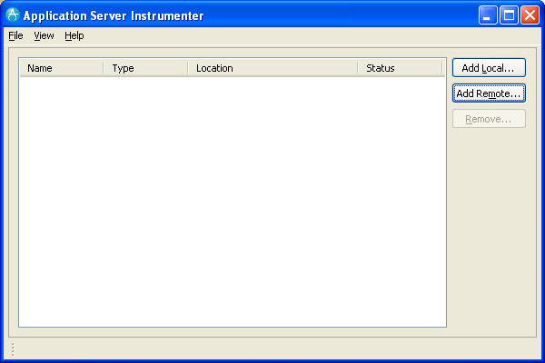
Application Server Instrumenter (ASI)

Slide 13
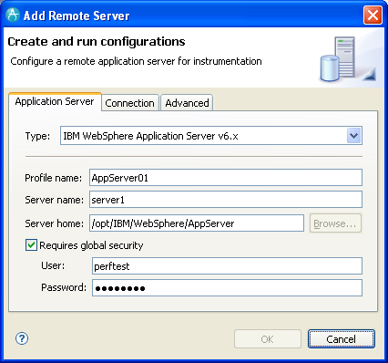
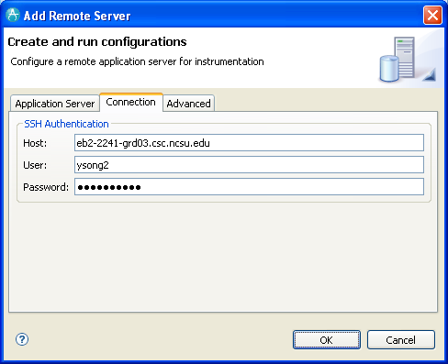
Application Server Instrumenter (ASI)

Slide 14
Application Server Instrumenter (ASI)
Application Server Tab
Type: IBM WebSphere Application Server v6.x
Profile name: AppSrv01
Server name: eb2-2241-grd03.csc.ncsu.edu
Server home: /opt/IBM/WebSphere/AppServer
User: perftest
Password: perftest
Connection Tab
Host: eb2-2241-grd03.csc.ncsu.edu or ldap.ncsu.edu (?)
User: ysong2
Password: <?>

Slide 15
…
{WAS_PROFILE_HOME}/config/cells/{cell_name}/nodes/{node_name}/servers/{server_name}
/opt/IBM/WebSphere/AppServer/profiles/AppSrv01/config/cells/eb2-2241-grd03Node01Cell/nodes/eb2-2241-grd03Node01/servers/server1/server.xml
/opt/IBM/WebSphere/AppServer/profiles/AppSrv01/config/cells/eb2-2241-grd03Node01Cell/nodes/eb2-2241-grd03Node01/servers/server1/variables.xml
{WAS_PROFILE_HOME}/config/cells/{cell_name}
/opt/IBM/WebSphere/AppServer/profiles/AppSrv01/config/cells/eb2-2241-grd03Node01Cell/pmirm.xml

Slide 16
…
/opt/IBM/SDP/DCI/rpa_prod/tivoli_comp/app/instrument/6.103.0000/appServers/server1_101/config

Slide 17
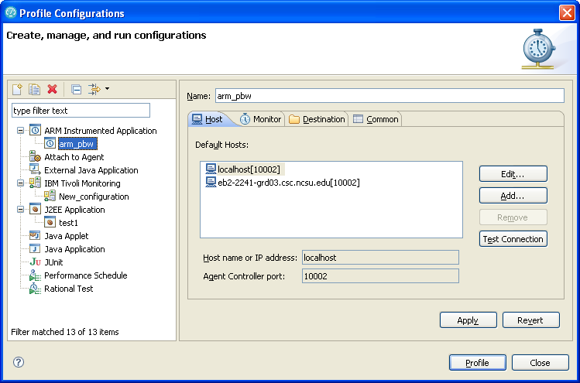
Profile Configurations

Slide 18
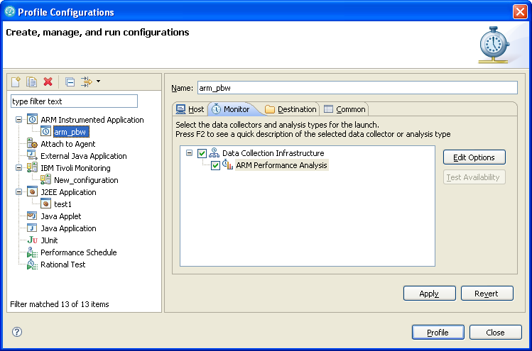
Profile Configurations (Cont’d)

Slide 19
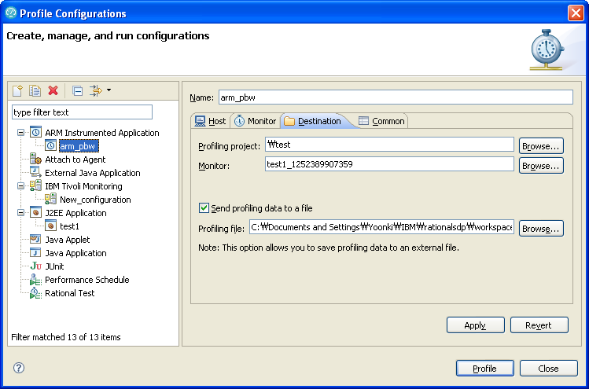
Profile Configurations (Cont’d)

Slide 20
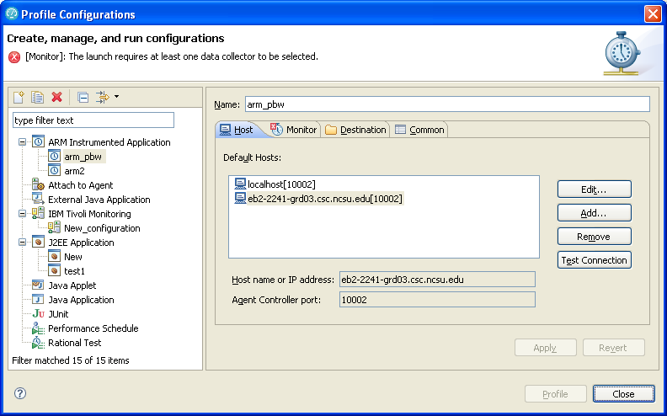

Slide 21
Comparing Trace data from RPT and TPTP

Slide 22
Start the Plant web application (AppSrv02, 9083, 9063)
Setup the environment for RPT profiling
Create a performance test suite for the Plant web application.
Run the performance test suite by RPT while collecting profiling data by RPT. The profiling data is stored in a local trcxml file (t1_rpt.trcxml)
Restart the Plant web application (after uninstrumentation)
Setup the environment for TPTP profiling
Run the performance test suite by RPT while collecting profiling data by TPTP. The profiling data is stored in a local trcxml file (t1_tptp.trcxml)
Compare t1_rpt.trcxml and t1_tptp.trcxml to figure out the difference.

Slide 23
Trouble Shooting

Slide 24
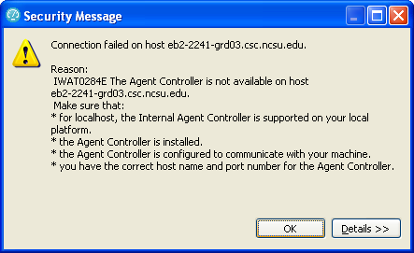
IWAT0284E

Slide 25
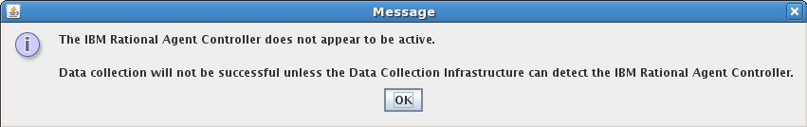
Trouble Shooting

Slide 26
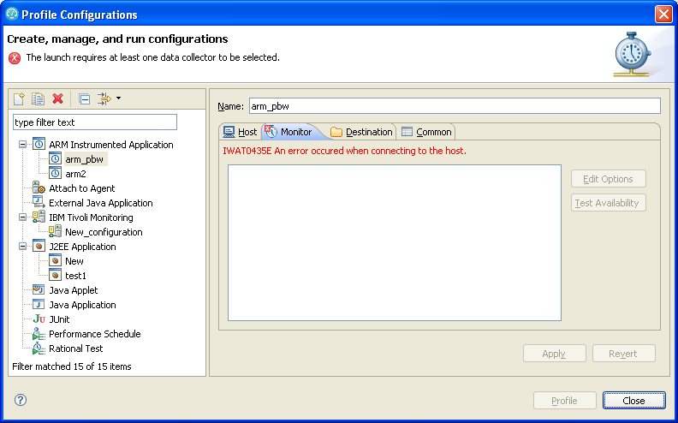
IWAT0435E

Slide 27
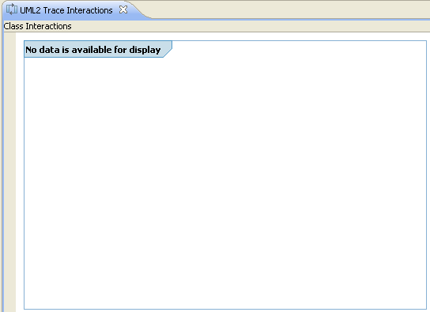
Trouble Shooting
No data available for display

Slide 28
IWAT0284E

Slide 29
Trouble Shooting

Slide 30
References
Install WebSphere Application Server V6.0 for Linux on POWER (http://www.ibm.com/developerworks/systems/library/es-webapp/index.html)
WebSphere Application Server 6.1 Headless Install (http://bishop.camp.clarkson.edu/wiki/en/WebSphere_Application_Server_6.1_Headless_Install)

Slide 31
References
Using IBM Rational Performance Tester: Application Monitoring Part 1, Configuring your environment (http://www.ibm.com/developerworks/rational/library/07/0515_patel/index.html)
Using IBM Rational Performance Tester: Application Monitoring Part 2, Enabling real-time monitoring (http://www.ibm.com/developerworks/rational/library/07/0515_patel2/index.html)
Using IBM Rational Performance Tester: Application monitoring, Part 3: Importing data from IBM Tivoli database products (http://www.ibm.com/developerworks/rational/library/07/0605_patel/index.html)

